Slide 1
Hypothesis Testing in Data Science
Topics to be covered:
Null vs Alternative Hypothesis
Error types
Critical Region, Significance level & P-Value
Population Variance Known
Population Variance Unknown
Parametric tests (Dependent & Independent Samples for Mean Test)
Sehrish Aqeel
www.aisciences.io

Slide 2
Null and Alternate Hypothesis
H₀: The null hypothesis: It is a statement of no difference between the variables–they are not related. This can often be considered the status quo and as a result if you cannot accept the null it requires some action.
H_{a}: The alternative hypothesis: It is a claim about the population that is contradictory to H₀ and what we conclude when we cannot accept H₀. This is usually what the researcher is trying to prove. The

Slide 3
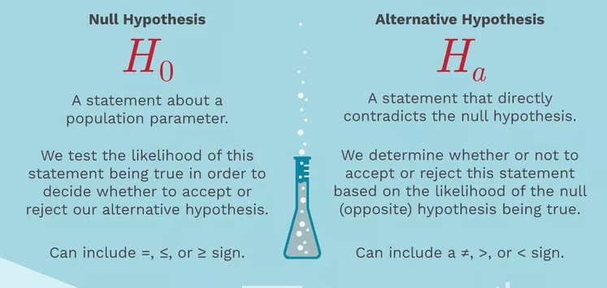
Null and Alternate Hypothesis

Slide 4
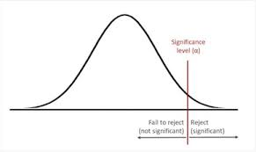
Significance Level
A confidence interval, also known as the acceptance region, is a set of values for the test statistic for which the null hypothesis is accepted. i.e. if the observed test statistic is in the confidence interval then we accept the null hypothesis and reject the alternative hypothesis.
Confidence intervals can be calculated at different significance levels.
We use α to denote the level of significance and perform a hypothesis test with a 100(1−α)% confidence interval.
Confidence intervals are usually calculated at 5% or 1% significance levels, for which α=0.05 and α=0.01 respectively.

Slide 5
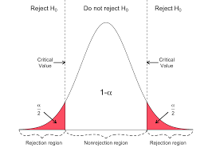
Critical Region
A critical region, also known as the rejection region, is a set of values for the test statistic for which the null hypothesis is rejected. i.e. if the observed test statistic is in the critical region then we reject the null hypothesis and accept the alternative hypothesis.
The critical value at a certain significance level can be thought of as a cut-off point. If a test statistic on one side of the critical value results in accepting the null hypothesis, a test statistic on the other side will result in rejecting the null hypothesis.

Slide 6
Quiz: Population Variance Unknown
Which test to perform if population variance is unknown?

Slide 7
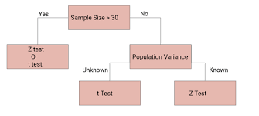
Answer

Slide 8
Quiz: Population Variance known
Which test to perform if population variance is known?

Slide 9
Answer

Slide 10
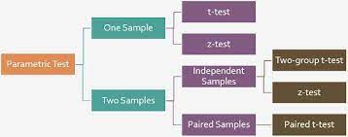
Summary: Parametric Tests

